Slide 1
Lecture 15 for loops

Slide 2
C for loops
In C, for loop is very similar to while loop.
Only difference between these two loops is that, in while loops, initialization, condition and increment/Decrement are done one by one and one after another.
But, in for loop code initialization, condition and increment/Decrement are done together.
So, coding gets much more efficient in for loop.

Slide 3
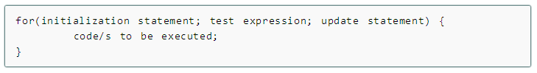
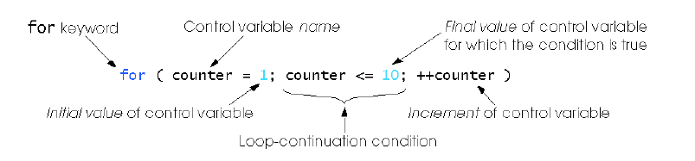
Syntax of for loops

Slide 4
Explanation:
The initialization statement is executed only once at the beginning of the for loop.
Then the test expression is checked by the program.
If the test expression is false, for loop is terminated.
But if test expression is true then the code/s inside body of for loop is executed and then update expression is updated.
This process repeats until test expression is false.

Slide 5
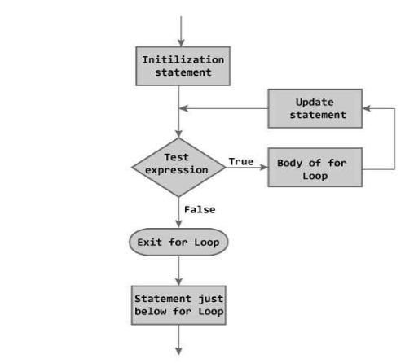
Flowchart of for loops

Slide 6
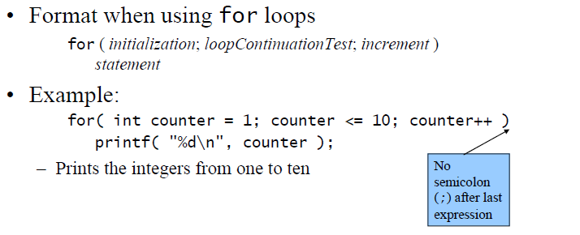
The for Repetition Statement

Slide 7
For loops can usually be rewritten as while loops:
initialization;
while ( loopContinuationTest )
{
statement;
increment;
}
Initialization and increment
– Can be comma-separated lists
– Example:
for (int i = 0, j = 0; j + i <= 10; j++, i++)
{
printf( "%d\n", j + i );
}

Slide 8
for loop example
Write a program to find the sum of first n natural numbers where n is entered by user. Note: 1,2,3... are called natural numbers.
#include <stdio.h>
int main(){
int n, count, sum=0;
printf("Enter the value of n.\n");
scanf("%d",&n);
for(count=1;count<=n;++count) //for loop terminates if count>n
{
sum+=count; /* this statement is equivalent to sum=sum+count */
}
printf("Sum=%d",sum);
return 0;
}

Slide 9
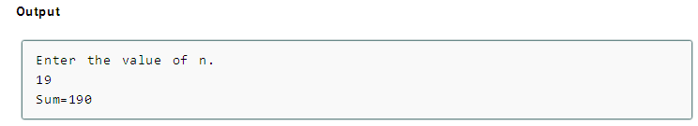

Slide 10
In this program, the user is asked to enter the value of n.
Suppose you entered 19 then, count is initialized to 1 at first.
Then, the test expression in the for loop,i.e., (count<= n) becomes true.
So, the code in the body of for loop is executed which makes sum to 1.
Then, the expression ++count is executed and again the test expression is checked, which becomes true.
Again, the body of for loop is executed which makes sum to 3 and this process continues.
When count is 20, the test condition becomes false and the for loop is terminated.
Note: Initial, test and update expressions are separated by semicolon(;).

Slide 11
Let us consider another example
#include <stdio.h>
int main()
{
int x;
/* The loop goes while x < 10, and x increases by one every loop*/
for ( x = 0; x < 10; x++ ) {
/* Keep in mind that the loop condition checks
the conditional statement before it loops again.
consequently, when x equals 10 the loop breaks.
x is updated before the condition is checked. */
printf( "%d\n", x );
}
return 0;
}

Slide 12
